Slide 1

HIVE-big data and hadoop. .CHALLENGE AND SOLUTION.

Slide 2
HADOOP
1.Hadoop modules.
2.Hadoop ecosystem sub-projects.

Slide 3

PIG vs. HIVE. .PREFERED BY- .PARTITIONS. .DRIVERS.

Slide 4
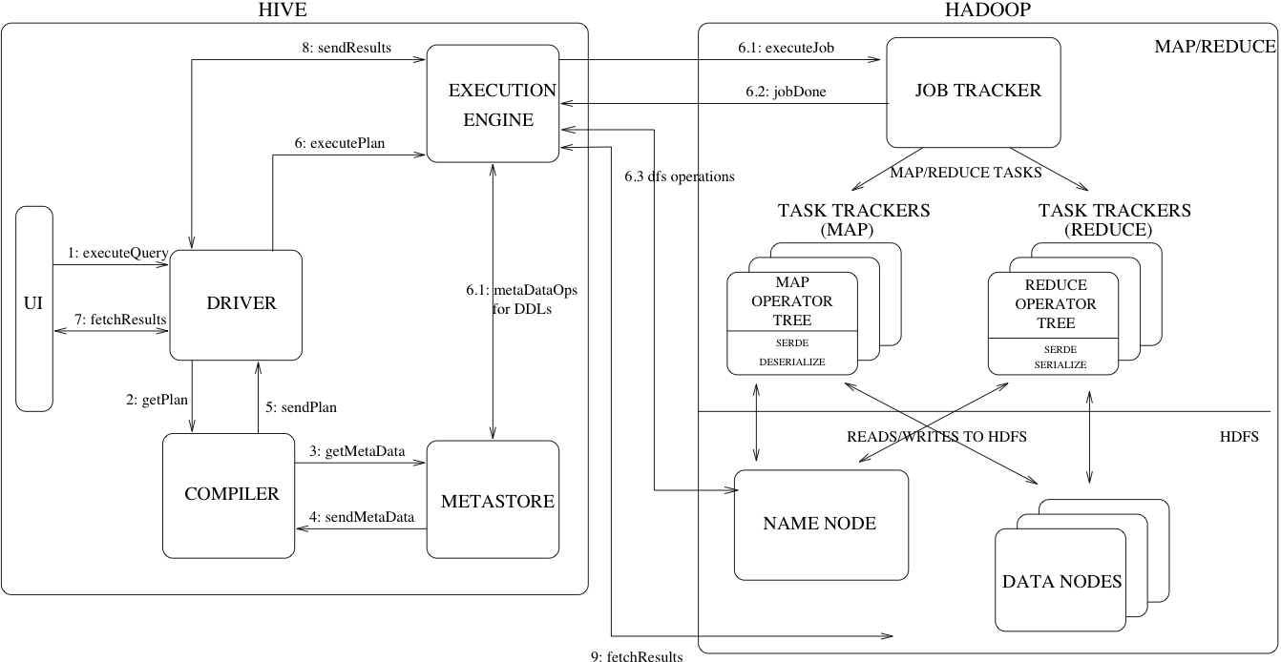
HIVE ARCHITECTURE.

Slide 5
DATA TYPES
.COLOUMN TYPES.
.LITERALS.
.NULL VALUES.
.COMPLEX TYPES.

